Slide 1



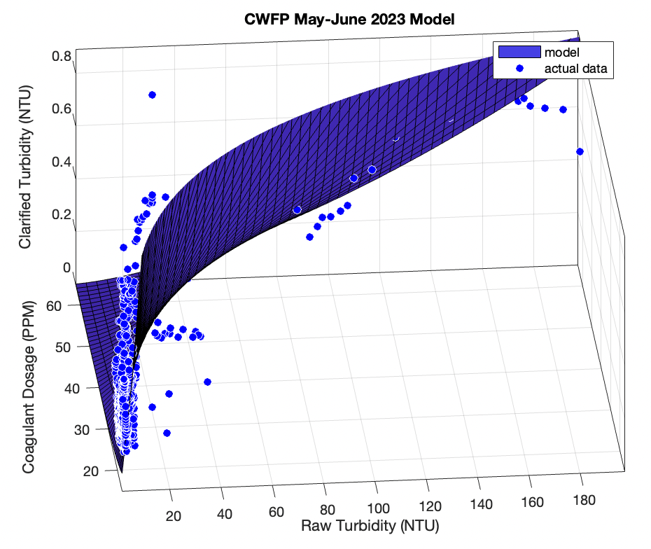
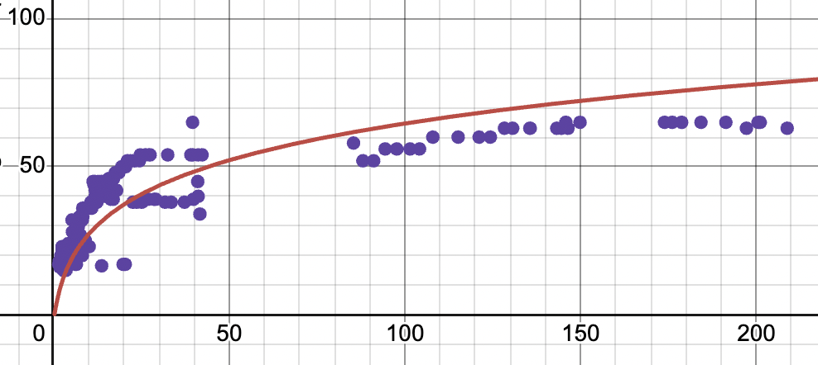
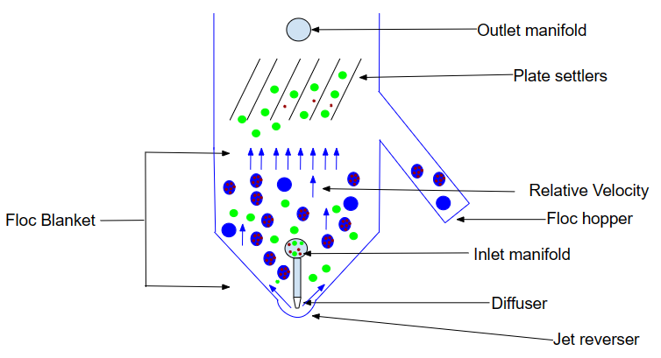

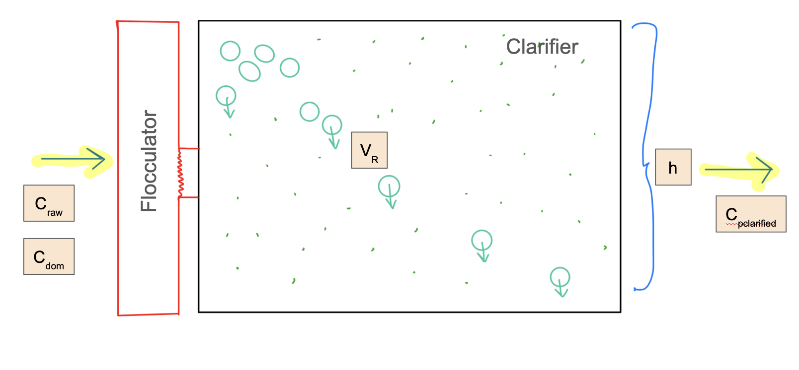
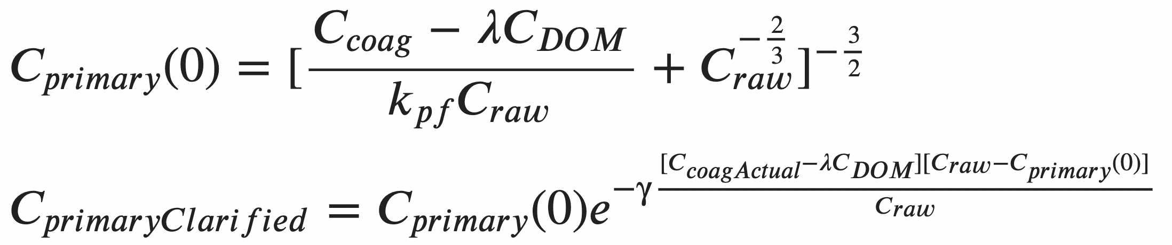
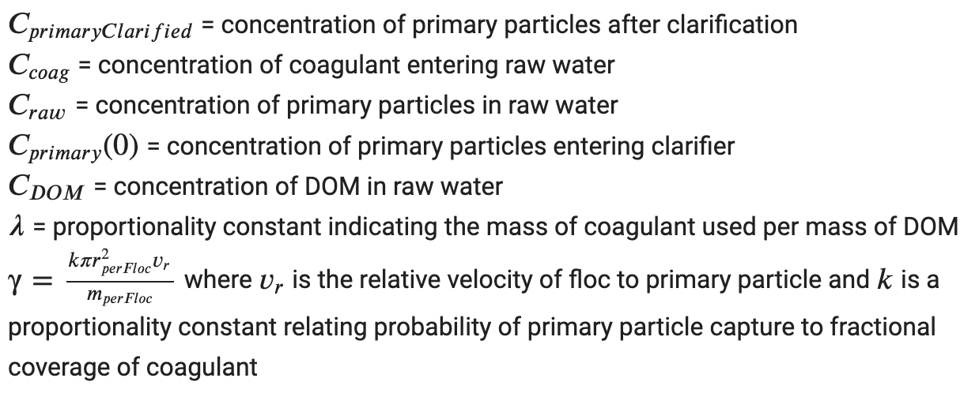
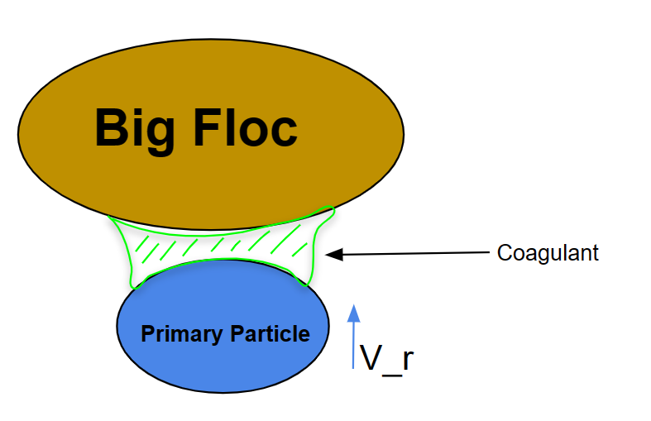
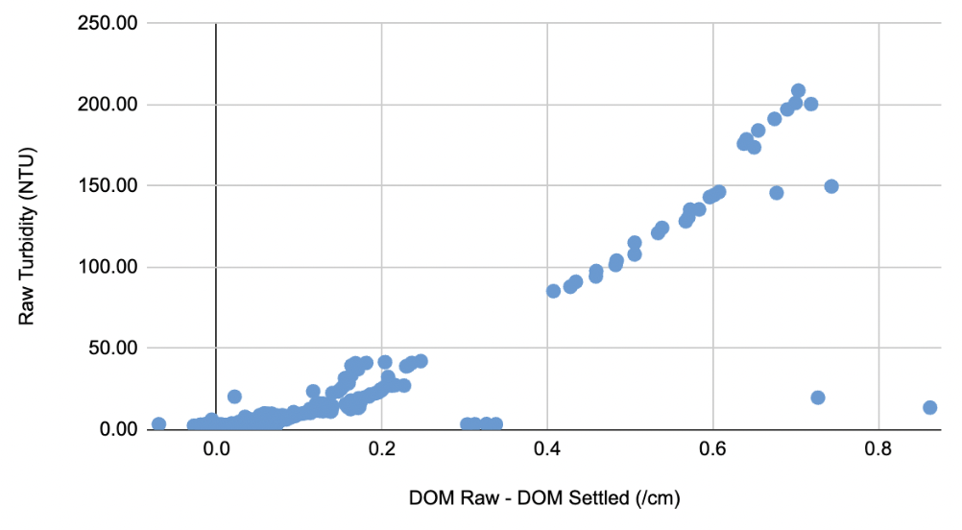
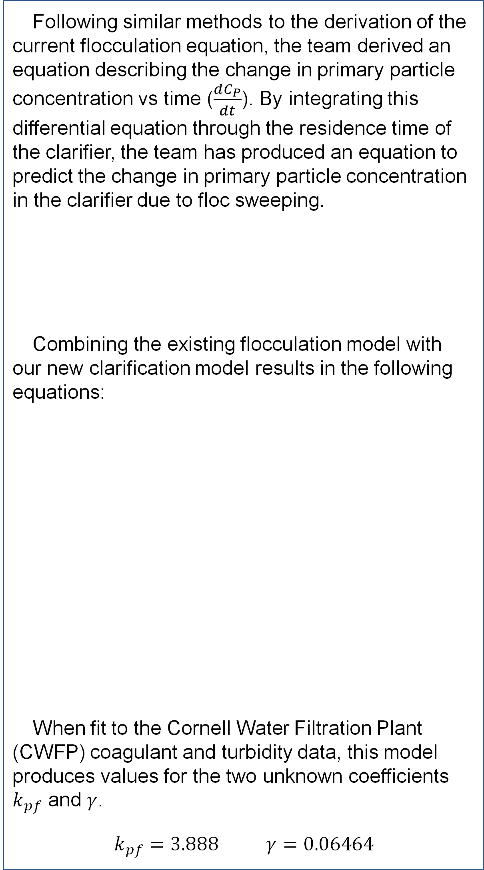
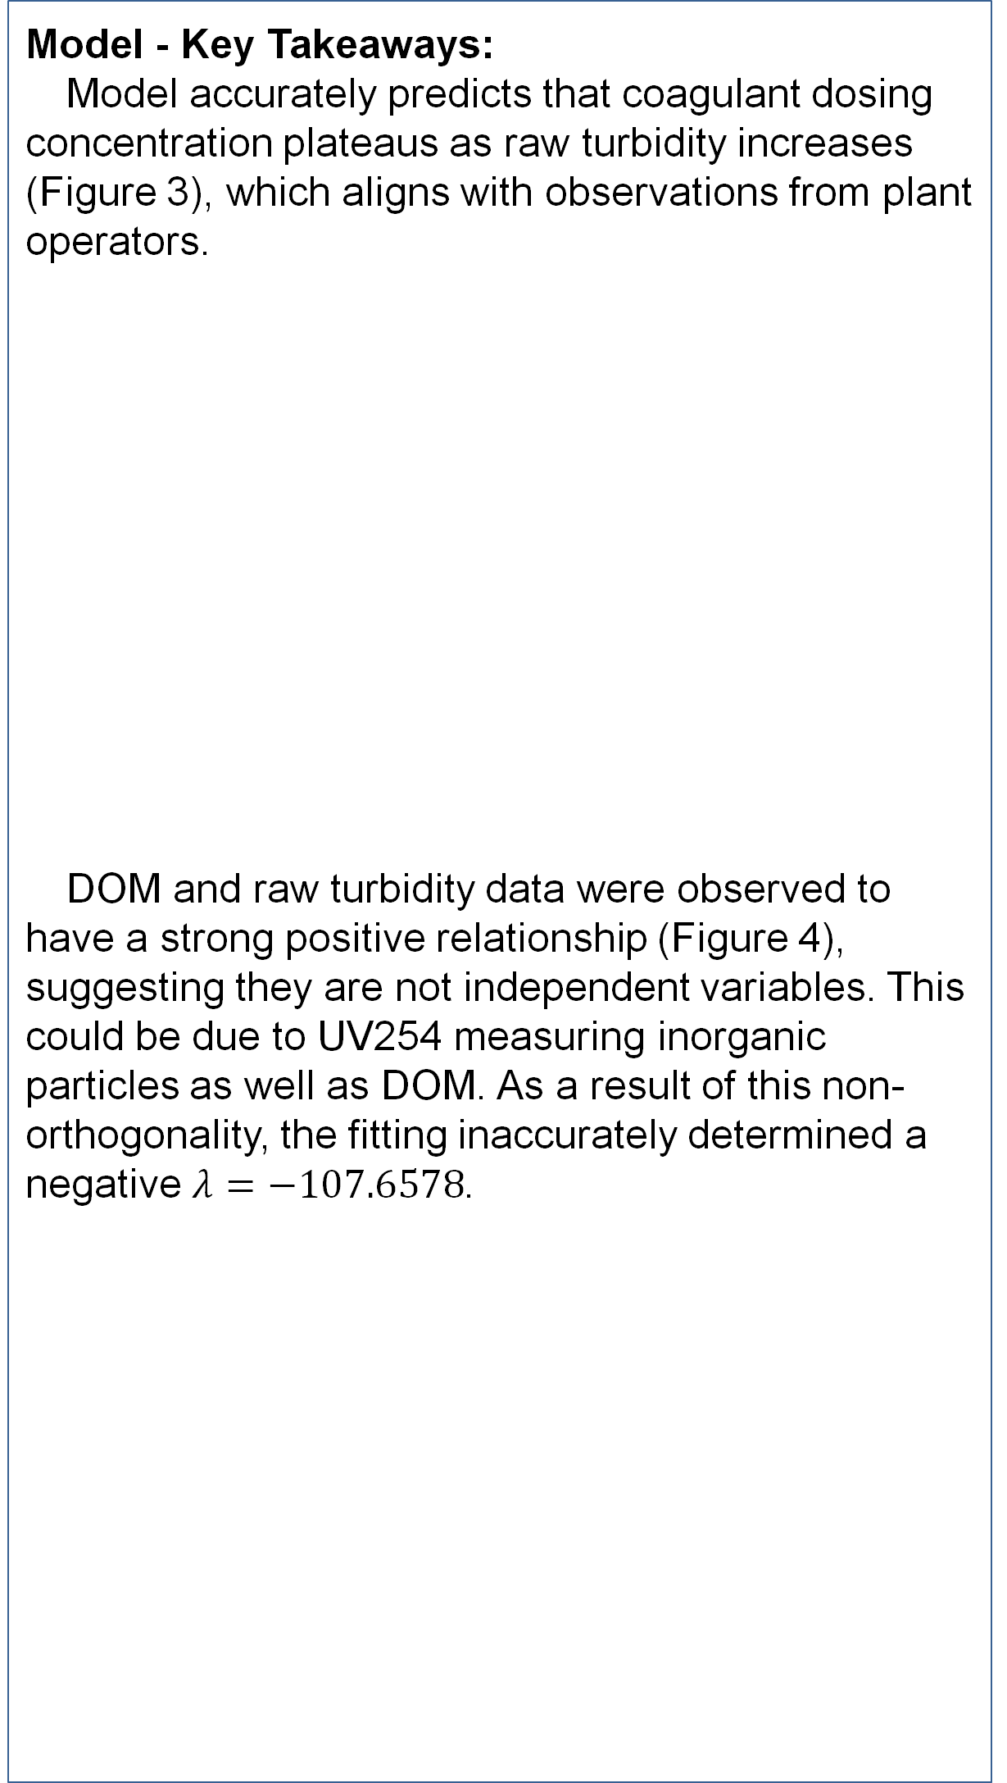
Coagulant Dosing: Simplifying Plant Operation
Kayla Stephenson | Ulises Balbuena Figueroa | Sweksha Mehta | Anjali Asthagiri | Alex Van Den Hende
Abstract
Methods
Results/Discussion I
Results/Discussion II
Coagulant dosing in the AguaClara water treatment process involves adding a specific amount of coagulant to influent water to remove pollutants, enhance floc formation, and neutralize water. For communities that cannot afford full-time operators, it is beneficial to create a fully automated coagulant dosing system.
Figure 1. Primary particle journey through the clarifier
Following similar methods to the derivation of the current flocculation equation, the team derived an equation describing the change in primary particle concentration vs time ($\frac{dC_{P}}{dt}$). By integrating this differential equation through the residence time of the clarifier, the team has produced an equation to predict the change in primary particle concentration in the clarifier due to floc sweeping.
Combining the existing flocculation model with our new clarification model results in the following equations:
When fit to the Cornell Water Filtration Plant (CWFP) coagulant and turbidity data, this model produces values for the two unknown coefficients $k_{pf}$ and $γ$.
$k_{pf}=3.888$ $γ=0.06464$
Model - Key Takeaways:
Model accurately predicts that coagulant dosing concentration plateaus as raw turbidity increases (Figure 3), which aligns with observations from plant operators.
DOM and raw turbidity data were observed to have a strong positive relationship (Figure 4), suggesting they are not independent variables. This could be due to UV254 measuring inorganic particles as well as DOM. As a result of this non-orthogonality, the fitting inaccurately determined a negative $λ=−107.6578$.
Coagulant Dosage (PPM)
Scan QR code for model derivations
Raw Turbidity (NTU)
Figure 5. Model fitting to CWFP data, assuming no DOM
Figure 3. Model fitting to CWFP data, assuming constant clarified turbidity of 0.24 NTU and no DOM
Introduction
To predict the proper dosing of coagulant, the team has derived a model to describe the effect of coagulant on floc sweeping in the clarifier.
Figure 2. Zooming in to floc sweeping process
Figure 6. Model of floc sweeping in the CWFP horizontal flow clarifier
Future Directions
We will run Plantita and collect data using ProCoDA.
We will monitor behavior during various turbidity events.
We will validate assumptions made from CWFP Data.
We will implement an automated coagulant dosing system in Puerto Rico.
Figure 4. Dependent relationship between DOM and raw turbidity
Contact
References
Kayla Stephenson
Agua Clara
ks929@cornell.edu
http://aguaclara.cornell.edu
410-424-9407
1. AguaClara Hydraulic Flocculation Model. AguaClara Hydraulic Flocculation Model - AguaClara v1.4.35 documentation. (n.d.). https://aguaclara.github.io/Textbook/Flocculation/Floc_Model.html
2. Clarification introduction. Clarification Introduction - AguaClara v1.4.35 documentation. (n.d.). https://aguaclara.github.io/Textbook/Clarification/Clarifier_Intro.html
3. Coagulant Automation. Coagulant Automation - AguaClara v1.4.35 documentation. (n.d.). https://aguaclara.github.io/Textbook/Operation/Coagulant_Automation.html
4. Du, Y., Pennock, W. H., Weber-Shirk, M. L., & Lion, L. W. (2019). Observations and a Geometric Explanation of Effects of Humic Acid on Flocculation. Environmental Engineering Science, 36(5), 614–622. https://doi.org/10.1089/ees.2018.0405
5. Kuan-Mu Yao, Mohammad T. Habibian, and Charles R. O'Melia Environmental Science & Technology 1971 5 (11), 1105-1112 DOI: 10.1021/es60058a005
‌

